Slide 1
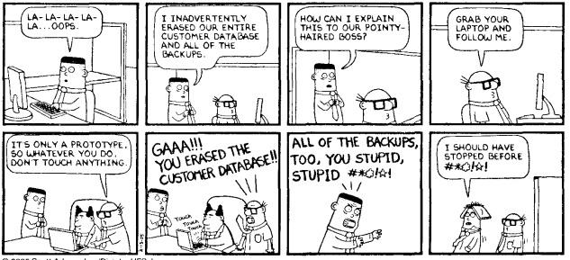
Welcome to CS3319/CS3120/DH3320
Introduction to Databases
Readings for Week 1:
Chapter 1: Database and Database Users
Chapter 2: Database System Concepts and Architecture
Chapter 7: Data Modeling Using the Entity Relationship Model
Course outline is in OWL.
08/29/16
CS3319

Slide 2
TODAY’S TOPICS
Overview of Course Outline
Basic Database Terminology
Database Concepts and Architecture
Entity-Relationship Diagrams
08/29/16
C53319

Slide 3
Instructor
Will Beldman
Office: MC365
Office Hours: Thursdays 11:30-12:15 (before class), or by appointment
Email: wbeldma@uwo.ca
  Subject: [3319] ...
08/29/16
C53319

Slide 4
Evaluation
Assignments → 7%, 8% and 15%
4 Quizzes → each worth 5%, I will drop your lowest mark (Sept 27, Oct 11, Oct 25, Nov 22)
Midterm Exam → 20% (Nov 8)
Final Exam → 35% (TBA)
08/29/16
C53319

Slide 5
Course Outline
http://owl.uwo.ca
08/29/16
C53319

Slide 6
Required Software
Virtual Machines on your system
  Built using VirtualBox/Vagrant
MySQL
Python
Flask
08/29/16
C53319

Slide 7



Learning Help Centre
Drop-in learning assistance
Room 4139, WSS
Presentations
FREE presentations on learning topics
Details at: sdc.uwo.ca/learning
Opens September 21st!
Hours:
Monday: 12:30pm-3:30pm
Tuesday: 10:30am-3:30pm
Wednesday: 10:30am-3:30pm
Thursday: 1:30pm-4:30pm
Friday: 11:30am-2:30pm
Topics Include:
Preparing for & Writing Multiple-choice Tests
Optimize Lecture Learning
Effective Textbook Strategies
Manage Test Stress
And more….
Individual Counselling
One-on-one Learning Skills appointment
Call 519-661-2183
Online Services
www.sdc.uwo.ca/learning
Printable calendars and handouts
Self-assessment checklists
Subscription to email newsletters
Meet with a Learning Skills Counsellor and discuss strategies to succeed in courses. This service is for all students: successful students wanting to strengthen their skills and those having academic difficulties.
@LSSatWestern

Slide 8
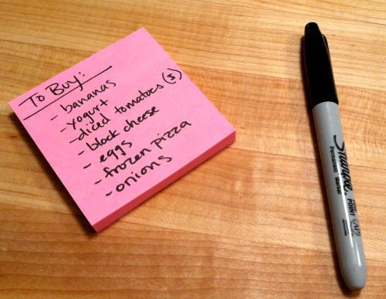
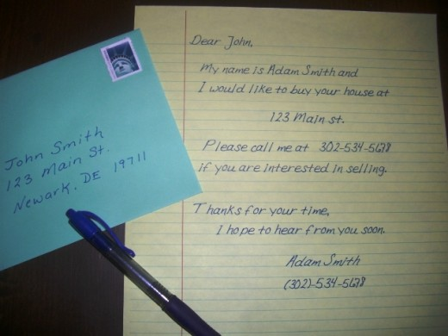
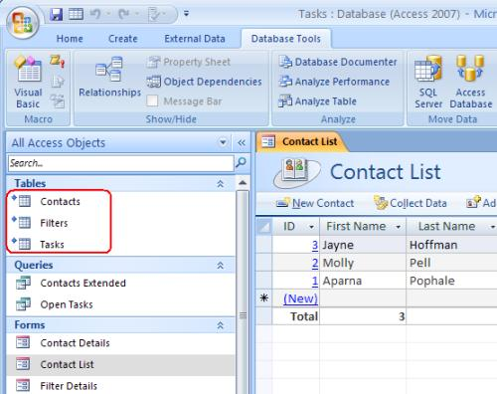
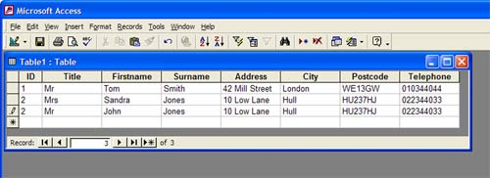
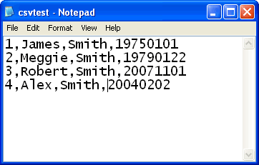
What is a database?
Which of the following are databases?
08/29/16
C53319

Slide 9
Basic Terminology
Data:
  Known facts that can be recorded and have an implicit meaning.
Database:
  A collection of related data.
Mini-world:
  A database is a model of a mini world. Some part of the real world about which data is stored in a database. E.g. medical office, a retail business, a library are all mini worlds
Database Management System (DBMS):
  A software package/system to facilitate the creation and maintenance of a computerized database.
Database System:
  The DBMS software together with the data itself. Sometimes, the applications are also included.
08/29/16
C53319

Slide 10

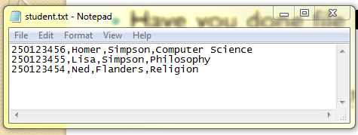
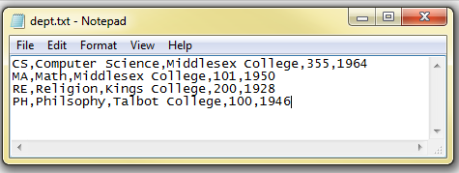
Life before DBMS… in the old days!
Have you done file I/O?
What is a “flat file”?
What is a “record”?
  Or “instance”
Identify the following:
  Data
  Flat File
  Record
  Database
08/29/16
C53319

Slide 11
What was so bad about flat files?
Any ideas? (Or…why are DBMS better than flat files?)
08/29/16
C53319

Slide 12
What is a Database Management System (DBMS)
Program to help users create, maintain and use a database
Advantages of DBMS over flat file system:
  Data redundancy/inconsistency reduced
  Isolates the programs from the data
  Provides persistent storage of data between execution of programs/applications
  Multiple users can use and share the data
  More abstract conceptually (views)
08/29/16
C53319

Slide 13
  Security, integrity and backups provided
  Generalized query tools
  Provides multiple user interfaces
  Possible to enforce standards since data is centralized
  Reduced development time
  Up to date information managed centrally
08/29/16
C53319

Slide 14
QUESTION: What are some disadvantages of using a DBMS over a flat file system?
08/29/16
C53319
Notes:
Cost
Initial Complexity
Require Skilled People

Slide 15
Who are the users involved?
Database Analysts/Administrators (DBAs)
System Analysts/Administrators (Sysadmins)
Programmer Analysts (Developers)
Database Designers
End Users
08/29/16
C53319

Slide 16
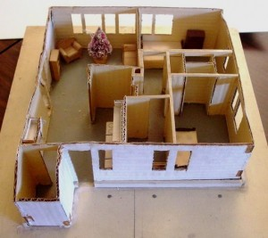
What do you do before you build a house? Or a car…or a business … or an airplane … or anything large?
08/29/16
C53319

Slide 17
Database Concepts & Definitions:
Data Model
  A set of concepts that can describe data – individual data items, their format and their inter-relationships, provides abstraction
  can be
    high-level (user perception of data) (entities, relations, etc) or
    low-level (physical) (how data stored) (access path, record ordering and indexing)
QUESTION: Which model worries about efficiency of the database? __________________________
08/29/16
C53319
Notes:
Low-Level

Slide 18
Schema
  A description of a database but not the data itself!
  Corresponds to the type in a programming language, or the abstract data type
Instance
  An occurrence of a data item described in the schema
Database State
  The data in the database at a moment in time
QUESTION: Changes occur frequently in schemas, instances or both?__________________________
08/29/16
C53319
Notes:
instances

Slide 19
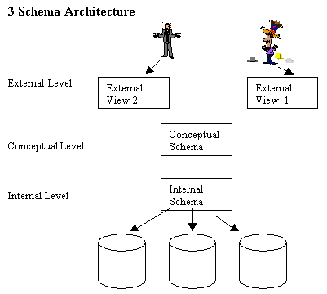
3 Schema Architecture
08/29/16
C53319

Slide 20
QUESTION: Where does the data reside?
QUESTION: Adding a field to the conceptual schema, will that change the views? How about deleting a field? Splitting up tables?
QUESTION: Dropping an index, will that change the conceptual schema? How about moving disks?
08/29/16
C53319
Notes:
Internal Schema
Adding a Field: No
Deleting a Field: Maybe, if it is in the view
Splitting up the tables: No
No, no

Slide 21
Data Independence
Logical data independence: ability to change the conceptual schema without changing the views
Physical data independence: ability to change the physical schema without changing the conceptual schema
Ok, you've purchased the DBMS, now how do you make it work?
08/29/16
C53319

Slide 22
Database Languages & Interfaces
DBMS Languages
Data Definition Language (DDL): used to define the schema or describe the data (conceptual schema)
Data Manipulation Language (DML): after the database is built, used to insert, delete and modify the data
08/29/16
C53319

Slide 23
Types of DMLS
High Level (set-oriented, can be stand-alone or embedded)
Low Level (procedural, record oriented, how to retrieve, must be embedded, record-at-a-time because you must use the languages (like C) loop structure to walk through and get each record).
Procedural: say how to get the answer
Non-procedural: say what the answer should be but not how to compute it
08/29/16
C53319

Slide 24
Classifications of DBMS
Data Model
Number of Users
Number of Sites
Type of Access Paths (how is the data physically stored)
Generality (built for a specific purpose or for any data)
08/29/16
C53319

Slide 25
Designing A Database
FORGET WHAT YOU KNOW FROM FIRST AND SECOND YEAR AND START WITH THE DATA FOR ANY APPLICATION DESIGN NOT PROCEDURES!
What would be the steps to designing a good database?
Find out the requirements of all groups (data and process)
Integrate the views then the conceptual schema is the union (minimal) of all views
Map to the data model provided by the DBMS (usually relational)
Design external views
Choose physical structures (indexes, etc.)
08/29/16
C53319

Slide 26
Entity Relationship Model
Created by Peter Chen in 1976
High Level Conceptual Data-Model.
VISUAL representation/diagram of your data (paper)
After modeling your data using the E-R model, you can map it to one of the currently used major models for implementing commercial databases (usually Relational).
08/29/16
C53319

Slide 27
Case Study – A Mini World:
Suppose we plan to model a company which is organized into departments.
Each department has a unique name, number and employee who manages it (we want to keep track of when the employee started managing the department)
A department may have several locations
A department controls a bunch of projects, each project has a unique number, name and a single location
Each employee has a name, ssnumber, address, salary, sex and birthdate
An employee is assigned to only one department but may work on several projects which are not necessarily from the same department
Keep track of the number of hours each employee works on each project.
Keep track of the direct supervisor of each employee
Keep track of the dependents of each employee (name, sex, birthdate and relation)
08/29/16
C53319

Slide 28
QUESTION: How can we represent the previous slide
  On paper
  Graphically/Visually
  Incorporating every aspect of the mini world we describe?
08/29/16
C53319

Slide 29

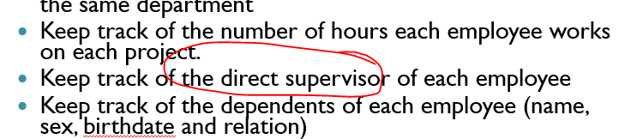
When designing a database → Nouns are important!
Usually nouns can either be:
  Entities
  Attributes
QUESTION: From the previous slide give an example of a noun that might be an entity and a noun that might be an attribute?
Think about the noun: supervisor. What would it be?
08/29/16
C53319

Slide 30
E-R Model Concepts
Entities and Attributes:
  Entity - A Thing, has independent existence →Employee
  Attribute – describes something → Age, SSN, Sex, Name
  Value - taken on by an attribute → 25, 456-876-788, Female, Bart Simpson
  Composite Attributes vs. Atomic or Simple Attributes →Bart Simpson vs. 45
  Single-Valued Attributes vs. Multivalued Attributes → Age vs. CollegeDegrees
  Derived Attributes vs. Stored Attributes → Age vs. Birthdate
08/29/16
C53319

Slide 31
  Null Values - Why and when would we use this?
    Apartment Number
    Phone Number
QUESTION: What is the difference between attributes with null values that are not applicable vs. not known?
https://youtu.be/bjvIpI-1w84
08/29/16
C53319
Notes:
Not applicable: Apt Number (some people may not have an apt number)
Not known: Phone Number (a person has a phone, but we don’t know the number at the current time)

Slide 32
Entity Types, Value Sets and Key Attributes
  Entity Type - defines a set of entities that have the same set of attributes
  Entity – an instance of an entity type
  Entity Set, Collections - group of Entities
  Key, Uniqueness
  Combination to create key
  Value Sets (Domains)
QUESTION: What is Age’s domain, what is Name's domain, what is Cost's domain?
08/29/16
C53319
Notes:
Age Domain 0-120
Names Domain: alphabetic keys, (might put a restriction on length)
Cost Domain: 0.00 to upper limit (or real numbers maybe?)

Slide 33
E-R Diagram Notation So Far:
Entity Type
Attribute
Key Attribute
Multi-valued Attribute
Composite Attribute
Derived Attribute
08/29/16
C53319

Slide 34
QUESTION: What are the entities from our example?
08/29/16
C53319
Notes:
Department
Employee
Dependent
Project

Slide 35
QUESTION: What is our diagram so far? (It is started below)
Department
Location
Name
Number
08/29/16
C53319

Slide 36
QUESTION: What haven’t we modeled yet?
Relationships & Roles
A Relationship is a named grouping of entities
A Relationship Set is an ordered list of entity sets
A Relationship Type R among n entity types E1, E2, ... En defines a set of associations among entities. Thus R is a set of relationship instances ri, where each ri associates n entities (e1, e2, ..., en) and each entity ej in ri is a member of entity type Ej, 1<=j<=n. Hence a relationship type is a mathematical relation on E1, E2, ... En.
08/29/16
C53319

Slide 37
e.g. The Relationship:
Employee WORKS FOR Department
Employee
WORKS FOR
Department
Laura
r1
Roberto
r2
Math
e3
r3
Computer Science
e4
r4
English
…
…
…
QUESTION: In the above diagram, how many entity types participate in the relationship?
08/29/16
C53319
Notes:
Two

Slide 38
Binary Relationship - Example
CourseNum
SNum
Course
takes
Student
CourseName
SName
08/29/16
C53319

Slide 39
Degree of a Relationship: Binary, Ternary, Unary
Unary
Relationship
SName
Quantity
Supplier
Project
Supply
Ternary Relationship
ProjName
Part
manages
Employee
PartNo
SSN
08/29/16
C53319

Slide 40
More Terminology
Recursive (Unary) Relationship: the same entity participates more than once in different roles
Attributes on Relationships: Quantity see above
Cardinality Ratio --> number of relationships instances that an entity can participate in, there are 3 common ones:
  One-To-One: Employee Manages Department
  Many-To-One: Employee Works_For Department
  Many-To-Many: Employee Works_On Project
QUESTION: What is the cardinality of: Man FATHERS Child?
QUESTION: Name another many to many relationship:
08/29/16
C53319
Notes:
Man fathers child → 1 to Many
Many to Many → Sister has Brother

Slide 41
QUESTION: What do you think the single and double lines mean?
Artist
draws
Picture
Person
owns
Pet
Woman
marries
Man
08/29/16
C53319

Slide 42
Participation Constraint: specifies whether the existence of an entity depends on it being related to another entity via the relationship type.
  Total (Mandatory) - every entity in the entity set MUST BE related to the other entity set via the relationship. (For example, every employee must Work_For a department)
  Partial (Optional) - some or part of the entity set are related to the other entity set but not necessarily all. (For example, some employees manage a department but not all)
  Other notation --> (min, max) where 0<=min<=max and max>=1. Each entity must participate in at least min and at most max relationships. Thus a min of 0 implies partial participation.
QUESTION: What is the participation of Child in: Man FATHERS Child?
QUESTION: What is the participation of Man in: Man FATHERS Child?
08/29/16
C53319
Notes:
Man Fathers Child → Child: Total, Man: Partial

Slide 43
QUESTION: In the following ER diagram, what does the (min, max) notation imply?
1
N
Department
CONTROLS
Project
(0, N)
(1,1)
08/29/16
C53319
Notes:
A 5 To Many relationship (there must be at least 5 branches)

Slide 44
Weak Entity Types
Have no key attribute of their own
Cannot exist without its identifying owner
Always has total participation with its identifying owner
The identifying owner does not have to have a weak entity (partial participation)
Can sometimes be represented at composite, multi-valued attributes
Use a dashed underline to show the partial key of the weak entity
Use a double outlined diamond to show the relationship with the owner entity
08/29/16
C53319

Slide 45
General Semantic Guidelines
Use either all singular names for the entities or all plural names but not both (preferably singular)
Try to use meaningful names, try to make the relationships read from left to right and from top to bottom
QUESTION: What’s wrong with this example?
Patient
Doctors
Treats
Is employee by
QUESTION: Label the cardinality on the above diagram:
Nurse
08/29/16
C53319
Notes:
Doctors is plural,
Should read left to right if possible
Should read top to bottom if possible
Cardinality: Patient is treated by Doctor: Many to Many
Doctor employees Nurse: One to Many

Slide 46
More Notation:
Weak Entity Type
Relationship Type
Identifying Relationship Type
Total Participation of E2 in R
Cardinality Ratio 1:N for E1:E2 in R
Structural Constraint (min, max) on participation of E in R
E1
E2
R
N
E1
1
E2
R
(min, max)
R
08/29/16
C53319

Slide 47
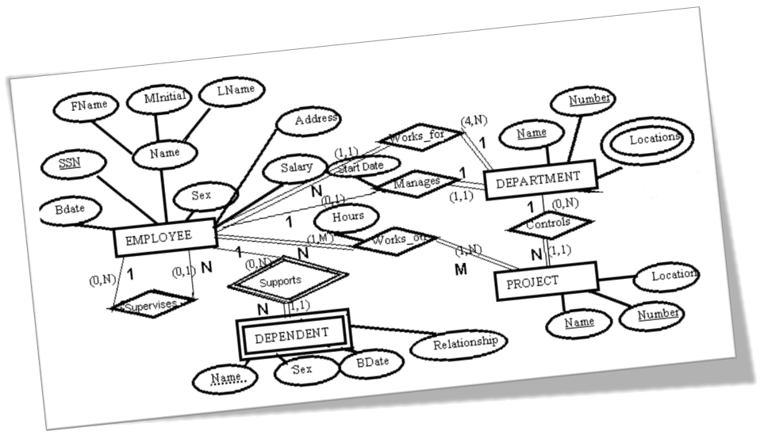
Our Example So Far:
08/29/16
C53319

Slide 48
Example 2: Try this yourself!
Suppose you want to store info about students applying for your university. You want to store info about the applying student (name, birth date, sex, address(es)...), the languages they speak, the high schools they attended and the universities they have applied to.
Draw an ER diagram for this scenario. (There are 2 different ways you could handle the languages)
08/29/16
C53319
Notes:
Entities:
Student, High School, Language, University
Relationships:
Attended, Applies to, Speaks

Slide 49
Newer Notation – Crow’s Foot Notation - ENTITIES
Instead of this:
Do this:
Patient
OHIPNum
LastName
FirstName
Patient
OHIPNum
FirstName
LastName
08/29/16
C53319

Slide 50
Crow’s Foot Notation - RELATIONSHIPS
Relationship indicated with just a line
End of the line indicates the cardinality and the participation:
  Zero or more
  One or more
  One and only one
  Zero or 1
08/29/16
C53319

Slide 51




Examples
One to One →
One to Many →
Many to Many →
One to Many →
Question: What is the participation on each example?
08/29/16
C53319

Slide 52
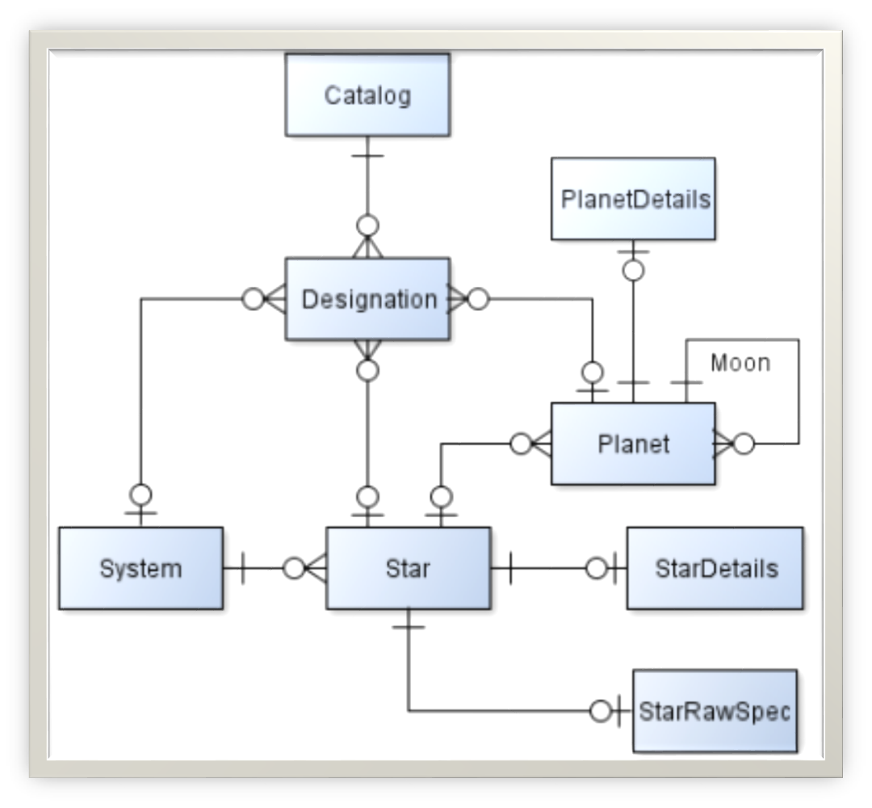
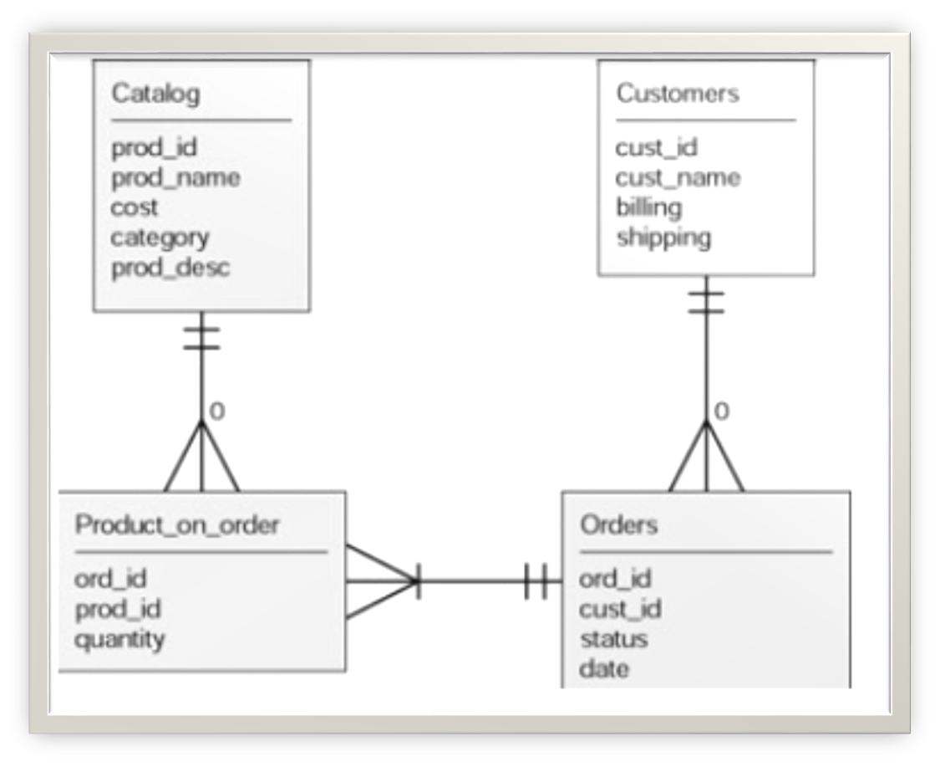
More examples
08/29/16
C53319

Slide 53
QUESTION: Draw the ER diagram for the following using Crow’s Foot Notation
Entities:
  Customer (customers may have never purchased from us before)
  Movie (movies we have in our system)
  Copy of DVD (actual DVD someone rents)
  Show the relationships: currently renting, and is a
Your Answer:
CUSTOMER
CustomerID
FirstName
LastName
DVDCOPY
DVDID
HomeStore
MOVIE
MovieID
Title
Year
Currently renting
Is a
08/29/16
C53319

